Slide 1
Prompt Engineering
Team – LLM Whisperers

Slide 2
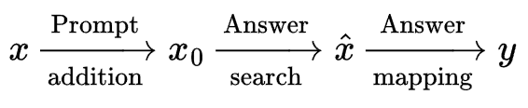
Introduction
Traditional supervised learning trains a model to take in an input x and predict an output y as P (y|x).
Prompt-based learning is based on language models that model the probability of text directly.
To use these models to perform prediction tasks, the original input x is modified using a template into a textual string prompt x₀ that has some unfilled slots, and then the language model is used to probabilistically fill the unfilled information to obtain a final string x̂, from which the final output y can be derived.

Slide 3
Why use prompt-based learning
This framework is powerful and attractive for several reasons: it allows the language model to be pre-trained on massive amounts of raw text, and by defining a new prompting function the model can perform few-shot or even zero-shot learning, adapting to new scenarios with few or no labeled data.

Slide 4
Two Sea Changes In NLP
Fully supervised learning, where a task-specific model is trained solely on a dataset of input-output examples for the target task, has long played a central role in many machine learning tasks. NLP tasks were no exception to this.
Because such fully supervised datasets are ever-insufficient for learning high-quality models, early NLP models relied heavily on feature engineering where NLP researchers or engineers used their domain knowledge to define and extract salient features from raw data and provide models with the appropriate inductive bias to learn from this limited data

Slide 5
Two Sea Changes In NLP
From 2017-2019,the standard shifted to the pre-train and fine-tune paradigm.
In this paradigm, a model with a fixed architecture is pre-trained as a language model (LM), predicting the probability of observed textual data. Because the raw textual data necessary to train LMs is available in abundance, these LMs can be trained on large datasets, in the process learning robust general-purpose features of the language it is modeling.

Slide 6
Two Sea Changes In NLP
The above pre-trained LM will be then adapted to different downstream tasks by introducing additional parameters and fine-tuning them using task-specific objective functions.
Within this paradigm, the focus turned mainly to objective engineering, designing the training objectives used at both the pre-training and fine-tuning stages.

Slide 7
Two Sea Changes In NLP
Now, as of 2021, we are in the middle of a second sea change, in which the “pre-train, fine-tune” procedure is replaced by one in which we dub “pre-train, prompt, and predict”.
In this paradigm, instead of adapting pre-trained LMs to downstream tasks via objective engineering, downstream tasks are reformulated to look more like those solved during the original LM training with the help of a textual prompt.
The advantage of this method is that, given a suite of appropriate prompts, a single LM trained in an entirely unsupervised fashion can be used to solve a great number of tasks.
However, as with most conceptually enticing prospects, there is a catch – this method introduces the necessity for prompt engineering, finding the most appropriate prompt to allow a LM to solve the task at hand.

Slide 8
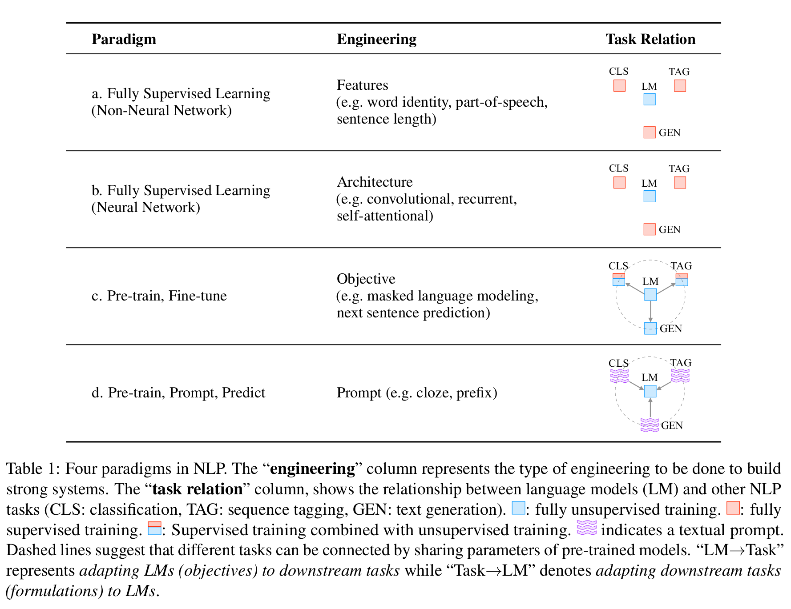

Slide 9
A formal description of Prompting
The main issue with supervised learning is that in order to train a model P (y|x; θ), it is necessary to have supervised data for the task, which for many tasks cannot be found in large amounts.
Prompt-based learning methods for NLP attempt to avoid this issue by instead learning an LM that models the probability P (x; θ) of text x itself and using this probability to predict y, reducing the need for large supervised datasets.

Slide 10
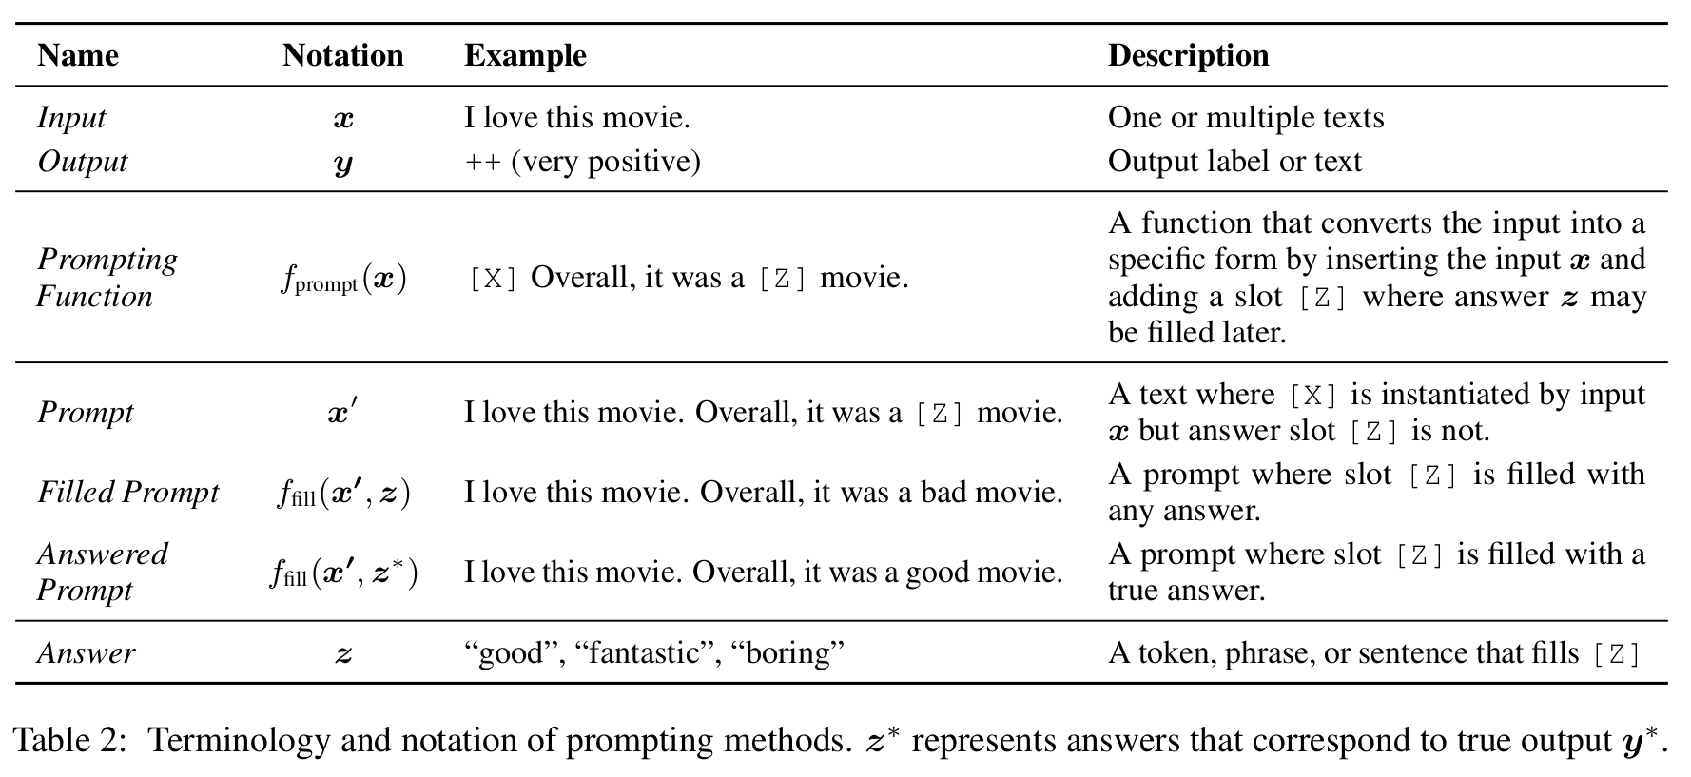
Prompting Basics

Slide 11
Prompt Addition
In this step a prompting function f_{prompt} (·) is applied to modify the input text x into a prompt x₀ = f_{prompt} (x).
This function consists of a two-step process:
Apply a template, which is a textual string that has two slots: an input slot [X] for input x and an answer slot [Z] for an intermediate generated answer text z that will later be mapped into y.
Fill slot [X] with the input text x.
Now, while generating this prompt we need to introduce a slot for z. For this task we have 2 options:
Cloze Prompt – We can put the slot in the middle.
Prefix Prompt – The input text comes entirely before z as a prefix.

Slide 12

Answer Search
We search for the highest-scoring text ẑ that maximizes the score of the LM. We first define Z as a set of permissible values for z.
We define a function f_{fill} (x₀ , z) that fills in the location [Z] in prompt x₀ with the potential answer z.
We will call any prompt that has gone through this process as a filled prompt. If the prompt is filled with a true answer, we will refer to it as an answered prompt.
Finally, we search over the set of potential answers z by calculating the probability of their corresponding filled prompts using a pre-trained LM P (·; θ).
This search function could be an argmax search that searches for the highest-scoring output, or sampling that randomly generates outputs following the probability distribution of the LM.

Slide 13
Answer Mapping
Finally, we would like to go from the highest-scoring answer ẑ to the highest-scoring output ŷ. This is trivial in some cases, where the answer itself is the output (as in language generation tasks such as translation), but there are also other cases where multiple answers could result in the same output. For example, one may use multiple different sentiment-bearing words (e.g., “excellent”, “fabulous”, “wonderful”) to represent a single class (e.g., “++”), in which case it is necessary to have a mapping between the searched answer and the output value.

Slide 14
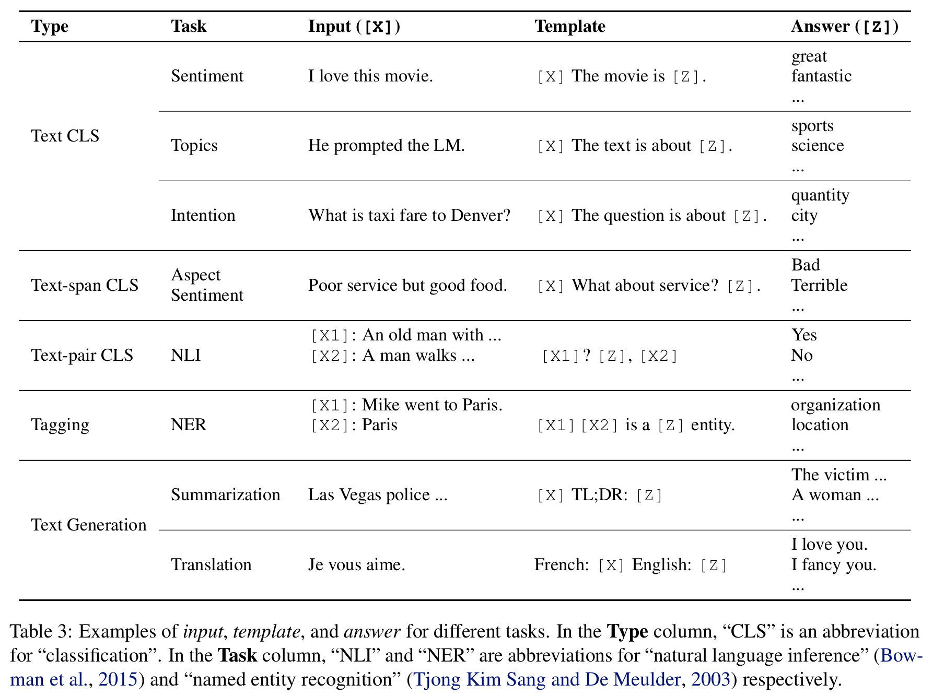

Slide 15
Design Considerations for Prompting
Pre-trained Model Choice: There are a wide variety of pre-trained LMs that could be used to calculate P (x; θ).
Prompt Engineering: Given that the prompt specifies the task, choosing a proper prompt has a large effect not only on the accuracy, but also on which task the model performs in the first place.
Answer Engineering: Depending on the task, we may want to design Z differently, possibly along with the mapping function.
Prompt-based Training Strategies: There are also methods to train parameters, either of the prompt, the LM, or both.

Slide 16
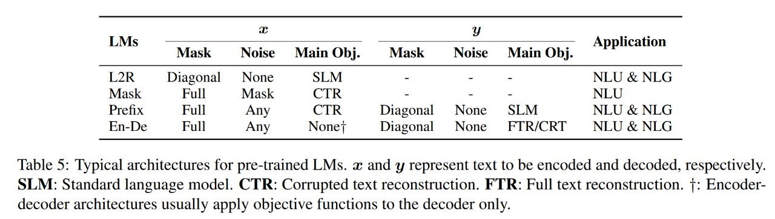
Different architectures for pre-trained LMs

Slide 17
Prompt Engineering
Prompt engineering is the process of creating a prompting function f_{prompt} (x) that results in the most effective performance on the downstream task.
In many previous works, this has involved prompt template engineering, where a human engineer or algorithm searches for the best template for each task the model is expected to perform.

Slide 18
Prompt Shape (Cloze vs Prefix)
The prompt shape to be chosen will depend both on the task and the model that is being used to solve the task.
In general, for tasks regarding generation, or tasks being solved using a standard auto-regressive LM, prefix prompts tend to be more conducive, as they mesh well with the left-to-right nature of the model.
For tasks that are solved using masked LMs, cloze prompts are a good fit, as they very closely match the form of the pre-training task.
Finally, for some tasks regarding multiple inputs such as text pair classification, prompt templates must contain space for two inputs, [X1] and [X2], or more.

Slide 19
Manual and Automated Template Engineering
Perhaps the most natural way to create prompts is to manually create intuitive templates based on human introspection.
The above approach seems intuitive and even gives positive results. But there are also several issues with this approach:
Creating and experimenting with these prompts is an art that takes time and experience, particularly for some complicated tasks such as semantic parsing.
Even experienced prompt designers may fail to manually discover optimal prompts.
Here the automated template engineering comes to rescue.
The automatically induced prompts can be further separated into discrete prompts, where the prompt is an actual text string, and continuous prompts, where the prompt is instead described directly in the embedding space of the underlying LM.
Another crucial design consideration is whether the prompting function f_{prompt} (x) is static, using essentially the same prompt template for each input, or dynamic, generating a custom template for each input.

Slide 20
Discrete Prompts
Works on discovering discrete prompts (hard prompts) automatically search for templates described in a discrete space, usually corresponding to natural language phrases. Several methods have been proposed for the same -
Prompt Mining - Find templates given a set of training inputs x and outputs y. This method scrapes a large text corpus (e.g., Wikipedia) for strings containing x and y, and finds either the middle words or dependency paths between the inputs and outputs. Frequent middle words or dependency paths can serve as a template as in “[X] middle words [Z]”.

Slide 21
Discrete Prompts
2. Prompt Paraphrasing - Paraphrasing-based approaches take in an existing seed prompt (e.g., manually constructed or mined), and paraphrases it into a set of other candidate prompts, then selects the one that achieves the highest training accuracy on the target task. This paraphrasing can be done in several ways,
using round-trip translation of the prompt into another language then back.
using replacement of phrases from a thesaurus
One can also perform paraphrasing after the input x is input into the prompt template, allowing a different paraphrase to be generated for each individual input.

Slide 22
Discrete Prompts
3. Gradient-based Search - We can apply a gradient-based search over actual tokens to find short sequences that can trigger the underlying pre-trained LM to generate the desired target prediction.
This search is done in an iterative fashion, stepping through tokens in the prompt .
Built upon this method we can automatically search for template tokens using downstream application training samples. This method shows an improved performance.

Slide 23
Discrete Prompts
4. Prompt Scoring - Davison et al. (2019) investigate the task of knowledge base completion and design a template for an input using LMs.
They hand-crafted a set of templates as potential candidates and fill the input and answer slots to form a filled prompt.
They then use a unidirectional LM to score those filled prompts, selecting the one with the highest LM probability.
This will result in custom template for each individual input.

Slide 24
Continuous Prompts
Because the purpose of prompt construction is to find a method that allows an LM to effectively perform a task, rather than being for human consumption, it is not necessary to limit the prompt to human-interpretable natural language. Because of this, there are also methods that examine continuous prompts (a.k.a. soft prompts) that perform prompting directly in the embedding space of the model. Specifically, continuous prompts remove two constraints:
relax the constraint that the embeddings of template words be the embeddings of natural language (e.g., English)words.
Remove the restriction that the template is parameterized by the pre-trained LM’s parameters. Instead, templates have their own parameters that can be tuned based on training data from the downstream task.
Several such methods have been explored such as -

Slide 25
Continuous Prompts
1. Prefix Tuning – It(Li and Liang, 2021) is a method that prepends a sequence of continuous task-specific vectors to the input, while keeping the LM parameters frozen.
Like Li and Liang,2021, Lester et al. (2021) prepend the input sequence with special tokens to form a template and tune the embeddings of these tokens directly.
Tsimpoukelli et al. (2021) train a vision encoder that encodes an image into a sequence of embeddings that can be used to prompt a frozen auto-regressive LM to generate the appropriate caption. They show that the resulting model can perform few-shot learning for vision-language tasks such as visual question answering etc. Different from the above two works, the prefix used in (Tsimpoukelli et al., 2021) is sample-dependent, namely a representation of input images, instead of a task embedding.

Slide 26
Continuous Prompts
2. Tuning Initialized with Discrete Prompts - There are also methods that initialize the search for a continuous prompt using a prompt that has already been created or discovered using discrete prompt search methods.
For example, Zhong et al. (2021b) first define a template using a discrete search method such as AUTOPROMPT(Shin et al., 2020)’s, initialize virtual tokens based on this discovered prompt, then fine-tune the embeddings to increase task accuracy. This work found that initializing with manual templates can provide a better starting point for the search process.
Qin and Eisner (2021) propose to learn a mixture of soft templates for each input where the weights and parameters for each template are jointly learned using training samples. The initial set of templates they use are either manually crafted ones or those obtained using the “prompt mining” method.

Slide 27
Answer Engineering
Answer engineering aims to search for an answer space Z and a map to the original output Y that results in an effective predictive model.
Two dimensions that must be considered when performing answer engineering are :
Answer Shape - The shape of an answer characterizes its granularity. Some common choices include:
Tokens: One of the tokens in the pre-trained LM’s vocabulary, or a subset of the vocabulary.
Span: A short multi-token span. These are usually used together with cloze prompts.
Sentence: A sentence or document. These are commonly used with prefix prompts.
In practice, how to choose the shape of acceptable answers depends on the task we want to perform.

Slide 28
Answer Engineering
2. Answer Space Design Methods - The next step is how to design the appropriate answer space Z, as well as the mapping to the output space Y if the answers are not used as the final outputs.
Manual Design: In manual design, the space of potential answers Z and its mapping to Y are crafted manually by an interested system or benchmark designer. There are several strategies that can be taken to perform this design.
Unconstrained Spaces - In many cases, the answer space Z is the space of all tokens, fixed-length spans, or token sequences. In these cases, it is most common to directly map answer z to the final output y using the identity mapping.
Constrained Spaces - There are also cases where the space of possible outputs is constrained. This is often performed for tasks with a limited label space such as text classification or entity recognition, or multiple- choice question answering. In these cases, it is necessary to have a mapping between the answer Z and the underlying class Y.

Slide 29
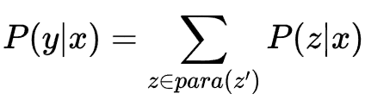

Answer Engineering
Discrete Answer Search: As with manually created prompts, it is possible that manually created answers are sub-optimal for getting the LM to achieve ideal prediction performance.
Answer Paraphrasing These methods start with an initial answer space, and then use paraphrasing to expand this answer space to broaden its coverage. Given a pair of answer and output, we define a function that generates a paraphrased set of answers. The probability P of the final output is then defined as the marginal probability all of the answers in this paraphrase set. This paraphrasing can be performed using any method.
where para(.) is the function that generates a paraphrased set of answers.
y is the final output.
z' scc, where Z is the intial answer space.

Slide 30
Answer Engineering
Prune-then-Search In these methods, first, an initial pruned answer space of several plausible answers Z is generated, and then an algorithm further searches over this pruned space to select a final set of answers.
Gao et al. (2021) first construct a pruned search space Z by selecting top-k vocabulary words based on their generation probability at the [Z] position determined by training samples. Then the search space is further pruned down by only selecting a subset of words within Z based on their zero-shot accuracy on the training samples.

Slide 31
Answer Engineering
2. Continuous Answer Search: Very few works explore the possibility of using soft answer tokens which can be optimized through gradient descent.
Hambardzumyan et al. (2021) assign a virtual token for each class label and optimize the token embedding for each class together with prompt embeddings.

Slide 32
Application
Factual Probing : Factual probing (a.k.a. fact retrieval) is one of the earliest scenarios with respect to which prompting methods were applied.
The motivation for exploring this task is to quantify how much factual knowledge the pre-trained LM’s internal representations bear.
In this task, parameters of pre-trained models are usually fixed, and knowledge is retrieved by transforming the original input into a cloze prompt, which can be manually crafted or automatically discovered.
Since the answers are pre-defined, fact retrieval only focuses on finding effective templates and analyzing the results of different models using these templates.

Slide 33
Application
Named Entity Recognition: Named entity recognition (NER) is a task of identifying named entities (e.g., person, name, location) in a given sentence.
Cui et al. (2021) proposed a template-based NER model using BART, which enumerates text spans and considers the generation probability of each type within manually crafted templates.
For example, given an input “Mike went to New York yesterday”, to determine what type of entity “Mike” is, they use the template “Mike is a [Z] entity”, and the answer space Z consists of values such as “person” or “organization”.

Slide 34
Application
Commonsense Reasoning: Some commonly attempted tasks involve identifying the antecedent of an ambiguous pronoun within context or involve completing a sentence given multiple choices.
For example, the given sentence is “The trophy doesn’t fit into the brown suitcase because it is too large.” and the model must infer whether “it” refers to the trophy or the “suitcase”. By replacing “it” with its potential candidates in the original sentences and calculating the probability of the different choices, pre-trained LMs can perform quite well by choosing the choice that achieves the highest probability.
For example, the given sentence can be “Eleanor offered to fix her visitor some coffee. Then she realized she didn’t have a clean [Z].”. The candidate choices are “cup”, “bowl” and “spoon”. The task for the pre-trained LM is to choose the one from the three candidates that most conforms to common sense.

Slide 35
Application
Text Generation: Text generation is a family of tasks that involve generating text, usually conditioned on some other piece of information. Prompting methods can be easily applied to these tasks by using prefix prompts together with autoregressive pre-trained LMs.
Radford et al. (2019) demonstrated impressive ability of such models to perform generation tasks such as text summarization and machine translation using prompts such as “translate to French, [X], [Z]”.

Slide 36
THANK YOU

